Slide 1
Julia Language 1.0 Ephemeris And Physical Constants Reader For Solar System Bodies Asteroid Shape Modeling
Julia Mihaylov
Embry-Riddle Aeronautical University
Aerospace Engineering Department
https://solarsystem.nasa.gov/images/galleries/p9_kbo_extras_orbits_2_1400.jpg
Courtesy of NASA/JPL-Caltech/UCLA/MPS/DLR/IDA
Notes:
A view of the asteroid Ceres, which the NASA Dawn spacecraft has been studying since 2015.CreditCreditNASA/JPL-Caltech/UCLA/MPS/DLR/IDA
Thank you for coming…
Co-authors

Slide 2
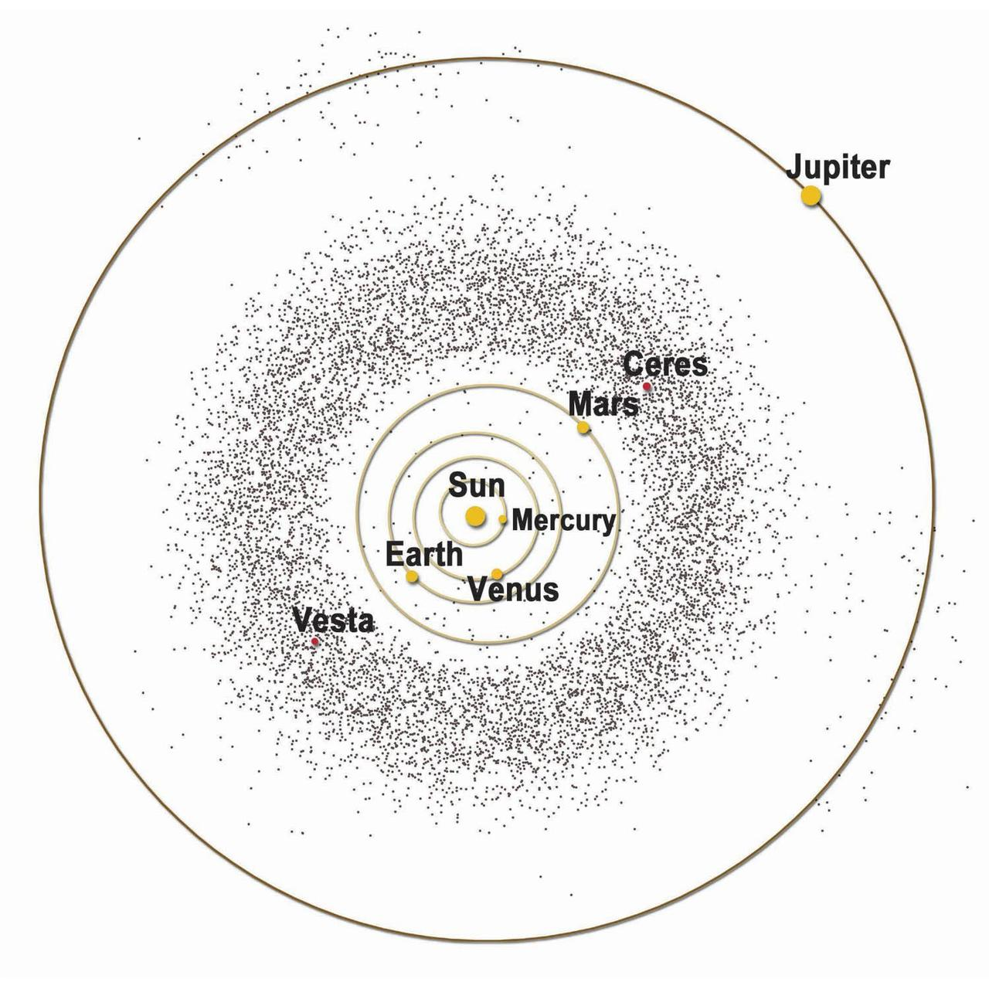
Acknowledgements
Dr. Damon Landau
Dr. Kaela Martin
Renee Spear
Tristan Minkoff
Courtesy of NASA.
Notes:
Original code in MATLAB
Major and small body characteristics
Lagrange points
Higher order spherical harmonics
Asteroid shape modeling

Slide 3
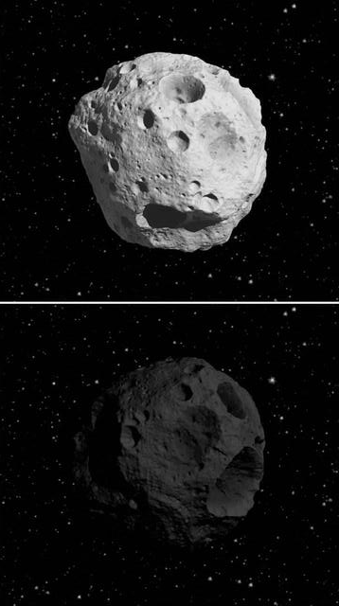
Boddat Significance
Retrieve updated ephemeris information
Simplify and aid future space missions
Improve available Julia Language library within NASA
Courtesy of NASA.
Notes:
Original code in MATLAB
Major and small body characteristics
Lagrange points
Higher order spherical harmonics
Asteroid shape modeling

Slide 4
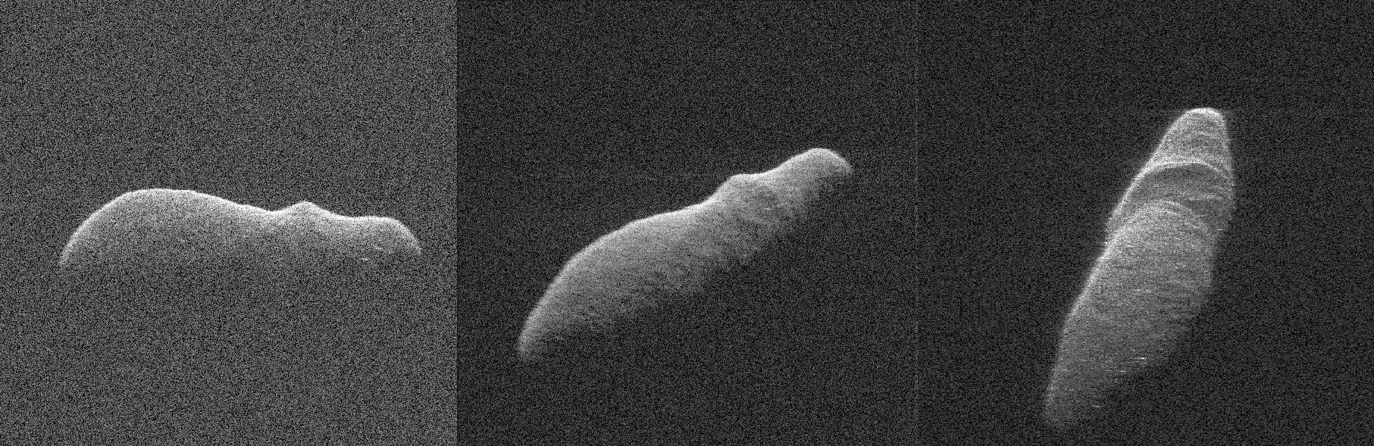
astermod
35 asteroid model properties available
Utilization of Database of Asteroid Models from Inversion Techniques (DAMIT)
Known asteroid ID, number, or name can be used
Courtesy of NASA.

Slide 5
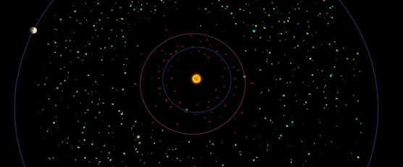
Applied Mathematics
Light curve inversion method
Shape models: polyhedrons with triangular surface facets
Nonzero linear change of the rotation rate - YORP
Courtesy of NASA.
Notes:
Yarkovsky–O'Keefe–Radzievskii–Paddack (YORP) effect

Slide 6
astermod Parameters
35 total asteroid and model properties available
Parameter Input | Output
lambda | Ecliptic longitude of the spin axis direction (J2000.0, in degrees)
beta | Ecliptic latitude of the spin axis direction (J2000.0, in degrees)
period | Sidereal rotation period (hours)
equiv_d | Equivalent diameter (km) – the diameter of a sphere that has the same volume as the shape model

Slide 7
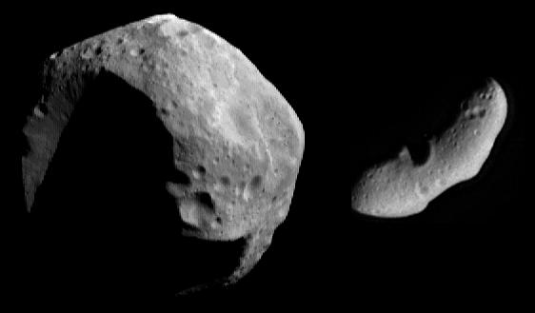
How to use astermod
model = astermod(“aster”, “prop”)
Courtesy of NASA.
Notes:
Julia works like Python in that additional libraries must be loaded for additional features
Questions:
JLD – allows Julia to save variables in a format similar to .mat in MATLAB
HDF5 - Hierarchical Data Format 5 , managing data collections of all sizes and complexity.

Slide 8

astermod $λ$Example
model = astermod(“109”, “lambda”)
Input | Meaning
109 | Asteroid ID
lambda | Ecliptic longitude of the spin axis direction (J2000.0, in degrees)
Notes:
Dict – Julia doesn’t have persistent storage variables, dict used as a workspace for the function
Allows he code save variables of different sizes and types into one structure
This one is just a placeholder but the code runs faster if a dictionary variable is specified

Slide 9
astermod $λ$Example
Input: model = astermod(“109”, “lambda”)
Output: Dict{Any,Any} with 2 entries:
“113” => “32”
“1806” => “36”
Output | Meaning
113 | Asteroid model ID
32 | Ecliptic longitude of the spin axis direction of asteroid model ID “113”
1806 | Asteroid model ID
36 | Ecliptic longitude of the spin axis direction of asteroid model ID “113”

Slide 10
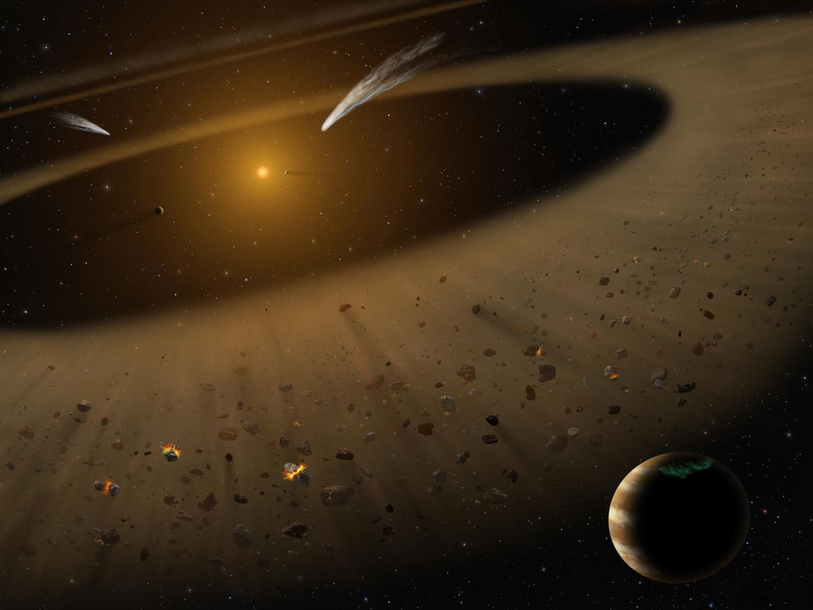

Questions?
Julia Mihaylov
mihayloj@my.erau.edu
Courtesy of NASA.
Notes:
Questions:

Slide 11
References
Bezanson, J., Edelman, A., Karpinski, S., and Shah, V. B., "Julia: A Fresh Approach to Numerical Computing," Soceity for Industrial and Applied Mathematics Review, Vol. 59, No. 1, 2015, pp. 65-98.
Englander, J. A. and Conway, B. A., "Automated Solution of Low-Thrust Interplanetary Trajectory Problem," Journal of Guidance, Control, and Dynamics, Vol. 40, No. 1, 2017, pp. 15-27.
Jiang, Y. Equilibrium Points and Orbits around Asteroid with the Full Gravitational Potential Caused by the 3D Irregular, Cornell University Library, 2018.
Reimond, S. and Baur, O., "Spheroidal and ellipsoidal harmonic expansions of the gravitational potential of Small Solar System Bodies. Case study: 67P/Churyumov-Gerasimenko," Journal of Geophysical Research, Vol. 121, No. 3, 2016.
Marson, R., Lagrasta, S., and Malvolti, F. "Computation of Precision Ephemeris coefficients in the GNSS message: Practical results from a proficient algorithm," IEEE AESS European Conference on Satellite Telecommunications, Rome, Italy, 2012.
Martin, K., Mihaylov, J., Spear, R., and Landau, D. "Julia Language Ephemeris and Physical Constants Reader for Solar System Bodies," AIAA Space Flight Mechanics Meeting, Kissimmee, FL, 2018.
Werner, R. and Scheeres, D., "Exterior gravitation of a polyhedron derived and compared with harmonic and mascon gravitation representations of asteroid 4769 Castalia," Celestial Mechanics and Dynamical Astronomy, Vol. 65, No. 3, pp. 313-344.
Takahashi, Y. and Scheeres, D., "Small body surface gravity fields via spherical harmonic expansions," Celestial Mechanics and Dynamical Astronomy, Vol. 119, No. 2, 2014.

Slide 12
References (cont.)
Kaasalainen, M. and Torppa, J., "Optimization methods for asteroid lightcurve inversion. I. Shape determination," Icarus, Vol. 153, 2001, p. 24.
Kaasalainen, M., Torppa, J., and Muinonen, K., "Optimization Methods for Asteroid Lightcurve Inversion II. The Complete Inverse Problem," Icarus, Vol. 153, 2001, pp. 37-51.
Durech, J. and Sidorin, V. Database of Asteroid Models from Inversion Techniques. http://astro.troja.mff.cuni.cz/projects/asteroids3D/web.php?page=project_main_page (accessed December 2018).
Aoki, S., Kinoshita, H., Guinot, B., Kaplan, G. H., and McCarthy, D. D. . S. P. K., "The New Definition of Universal Time," Astronomy and Astrophysics, 1982, pp. 359-361.
Chobotov, V. A. Orbital Mechanics, American Institute of Aeronautics and Astronautics, Reston, 2002.
Paolicchi, P. and Knežević, Z., "Footprints of the YORP effect in asteroid families," Icarus, Vol. 274, 2016, pp. 314-326.
Holdaway, R. "Satellite ephemeris prediction and orbit maneuverability by low thrust," 11th Electric Propulsion Conference, 1975.
Stoneking, E. T., Neerav, S., and Dean, C. J. "Real-Time Visualization of Spacecraft Telemetry for the GLAST and LRO Missions," SpaceOps Conference, Huntsville, AL, 2010.
Vasile, M., Ceriotti, M., Becerra, V. M., and Nasuto, S. J., "An Incremental Algorithm for the Optimization of Multiple Gravity Assist Trajectories," Computational Intelligence in Aerospace Sciences, 2014, pp. 745-779.

